Slide 1
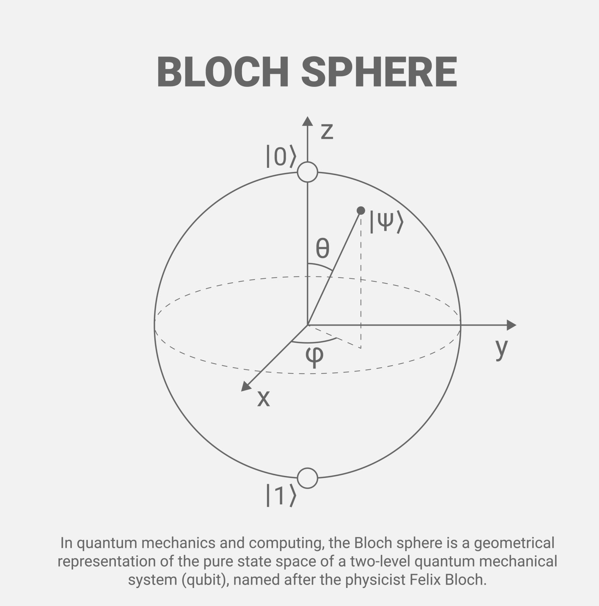

What is Quantum Computing?
Quantum computing is a computing paradigm that uses qubits and principles of quantum mechanics to process information.
Classical Bit vs Qubit
Classical Bit → Either 0 or 1
Qubit → Can be in superposition
$$\left.\left.\left.∣ψ\right\rangle =α∣0\right\rangle +β∣1\right\rangle$$

Slide 2
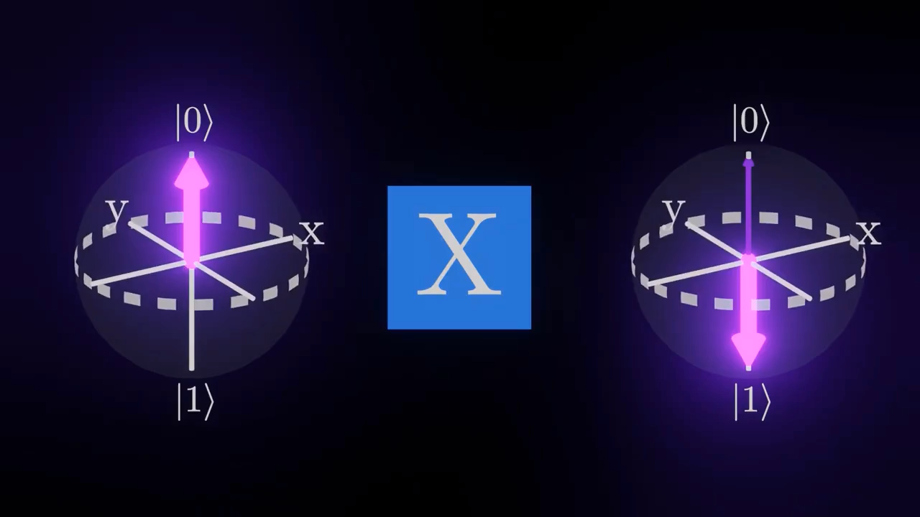
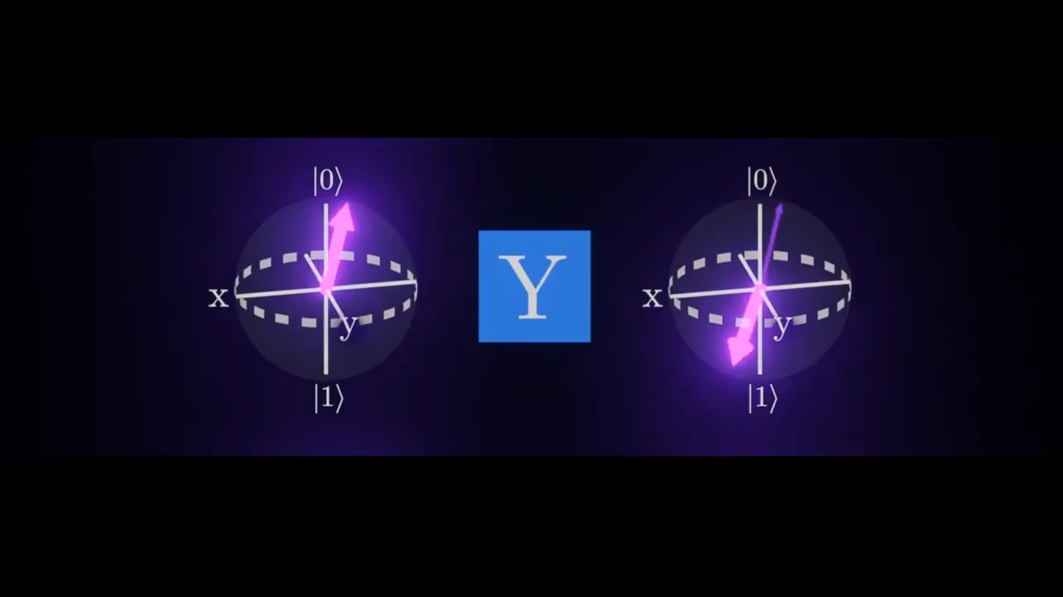
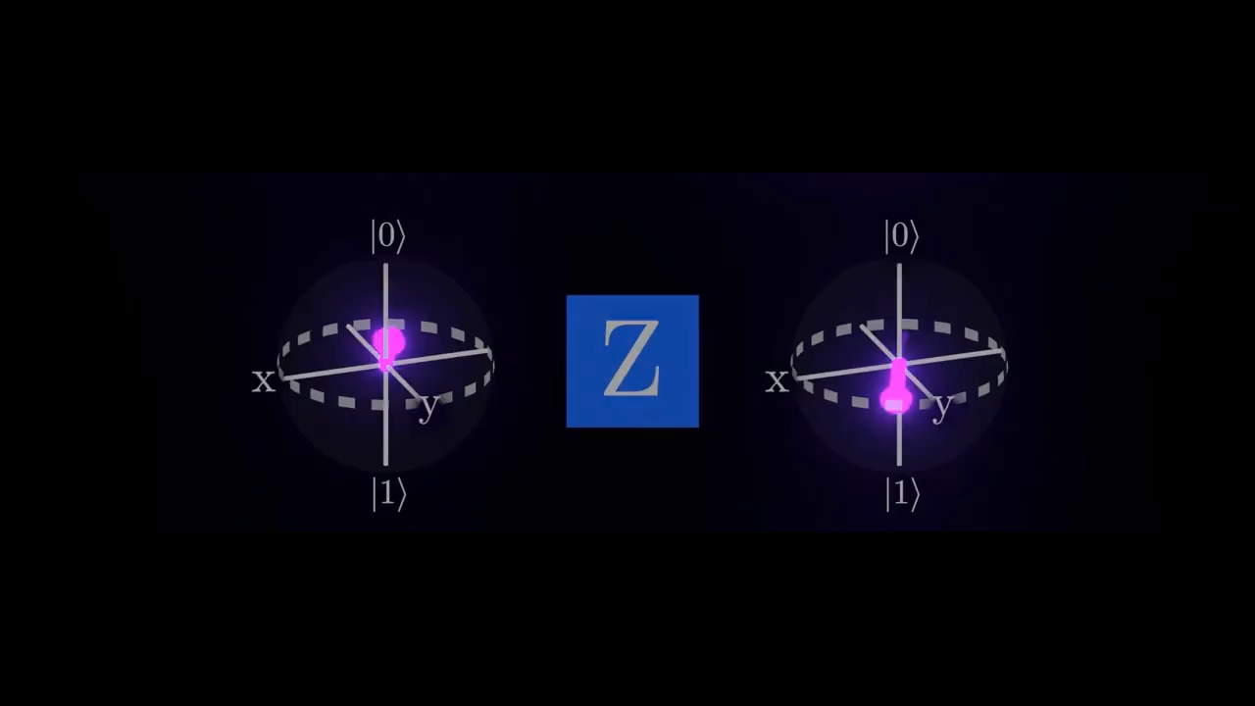

Slide 3
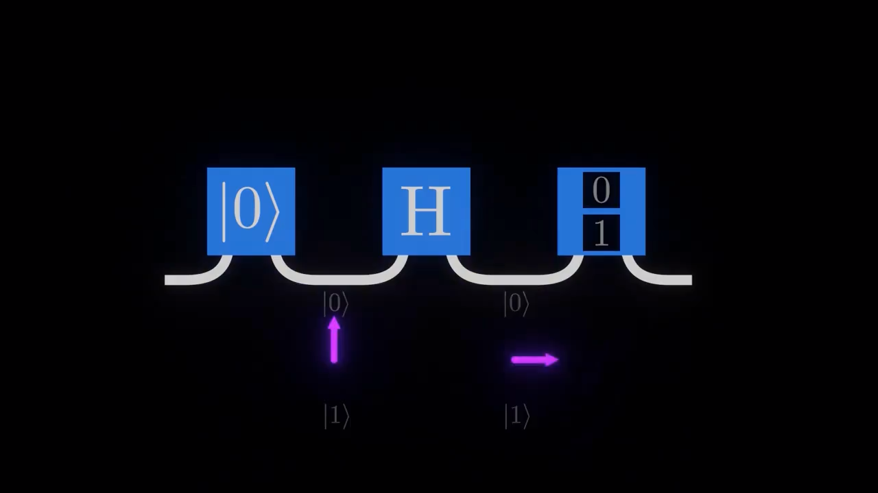

Slide 4
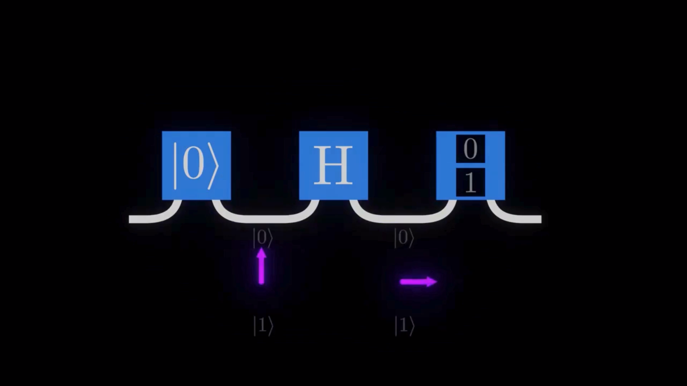

Slide 5
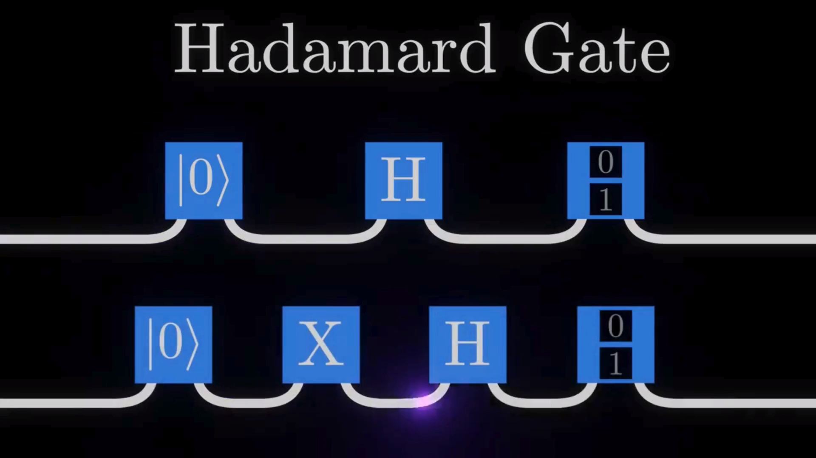

Slide 6
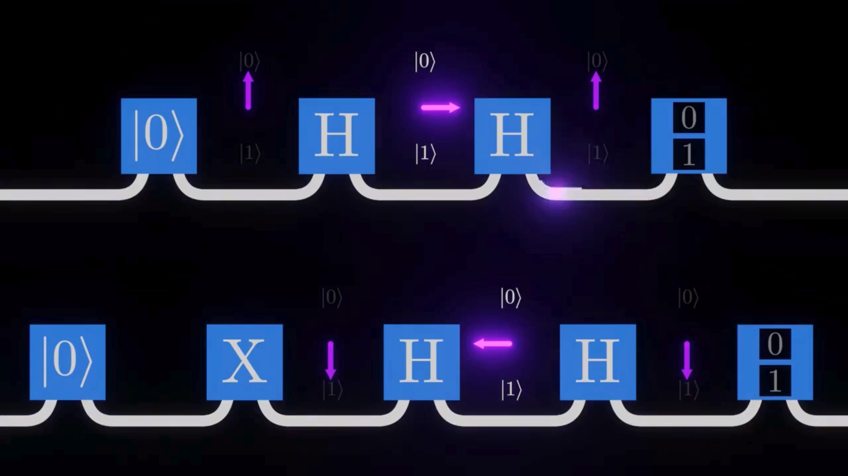

Slide 8

Why Do We Need Quantum Gates?
Role of Quantum Gates
Manipulate qubit states
Perform quantum operations
Build quantum circuits
Enable quantum algorithms
Classical vs Quantum Perspective
Classical gates → Change bits (0 or 1)
Quantum gates → Transform probability amplitudes
$$\left.\left.∣ψ^{′}\right\rangle =U∣ψ\right\rangle$$
where $U$= Unitary matrix
In classical computing, logic gates like AND and OR manipulate bits. Similarly, in quantum computing, quantum gates manipulate qubits.
However, instead of simply flipping between 0 and 1, quantum gates transform probability amplitudes using unitary matrices.

Slide 9


Properties of Quantum Gates
Reversibility
All quantum gates are reversible
No information is lost
Every gate has an inverse
2. Unitary Operation
Quantum gates are represented by unitary matrices.
$$U^{†}U=I$$
where
$U^{†}$= Conjugate transpose
$I$= Identity matrix
This ensures probability is preserved.
3. Probability Preservation
If $\left.\left.\left.∣ψ\right\rangle =α∣0\right\rangle +β∣1\right\rangle$
then $∣α∣^{2}+∣β∣^{2}=1$
remains unchanged after applying a quantum gate.
4. Composability
Quantum gates can be combined
Form quantum circuits
Enable complex quantum algorithms

Slide 10
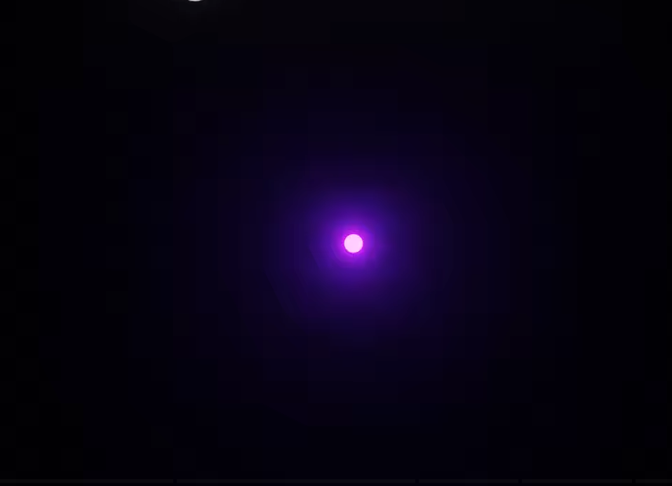
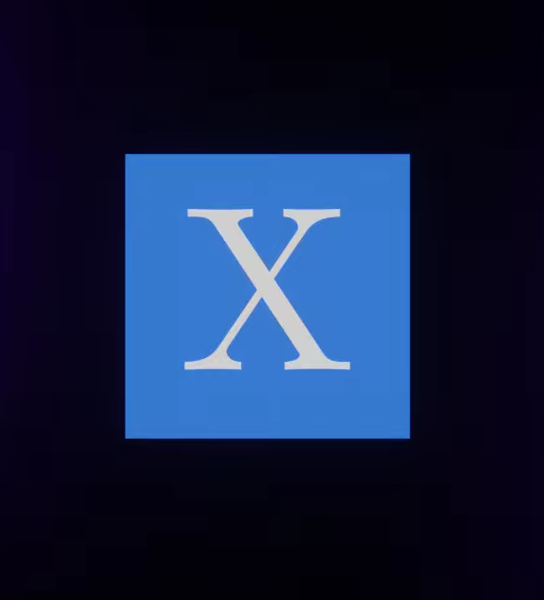
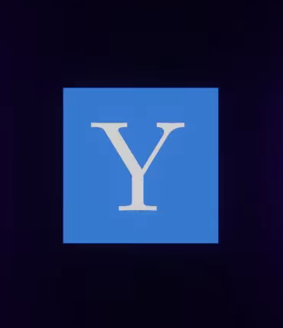

Single Qubit Gates
Qubit

Slide 11
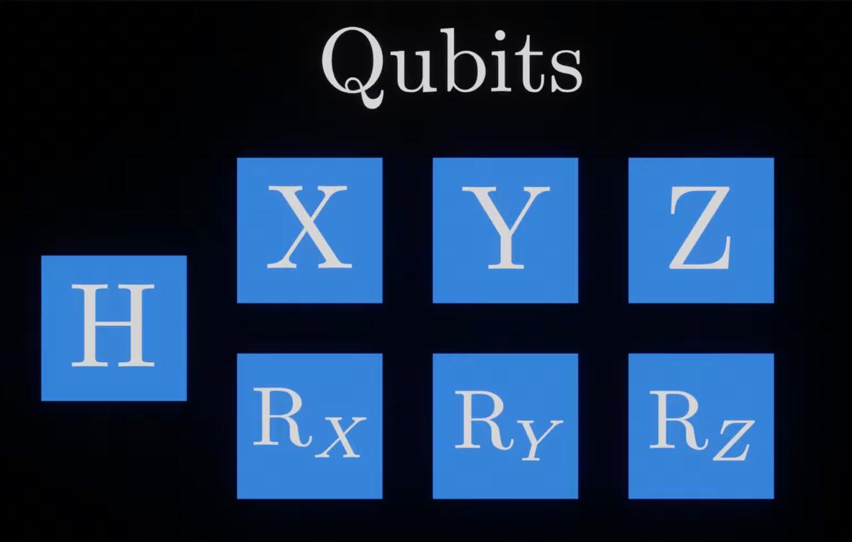

Slide 12
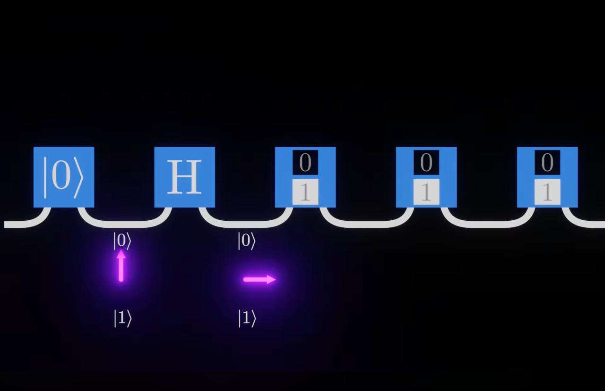

Slide 13
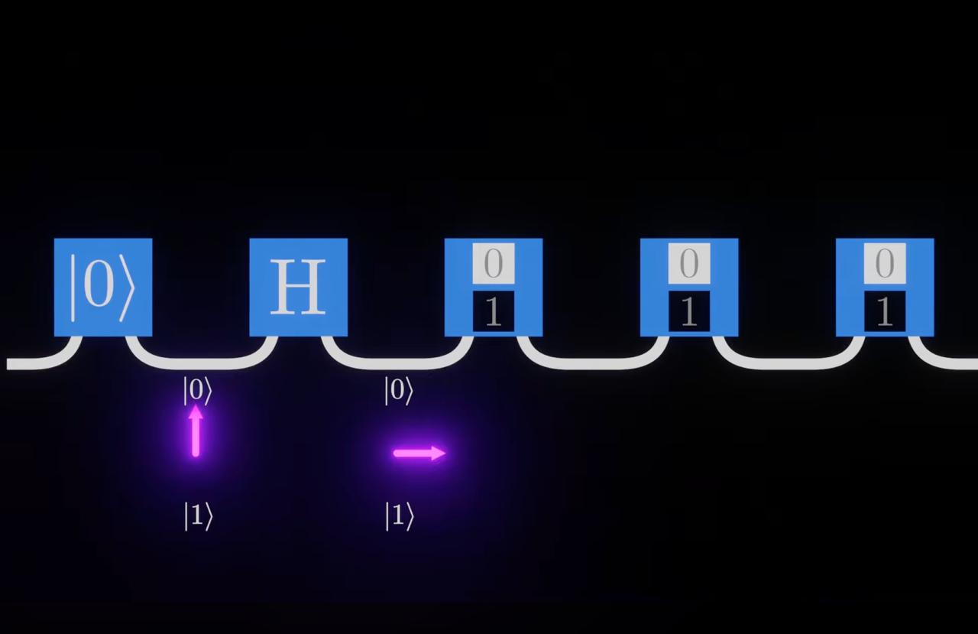

Slide 14
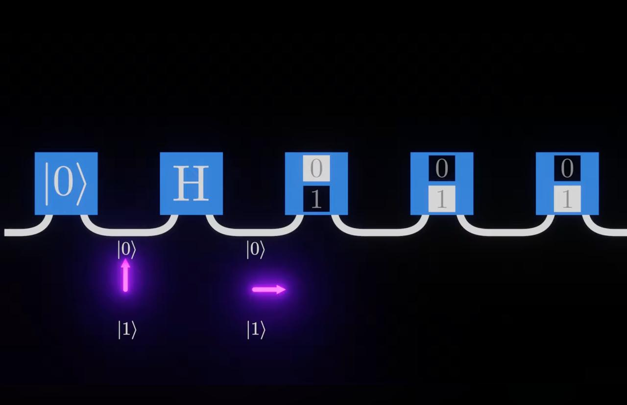

Slide 15
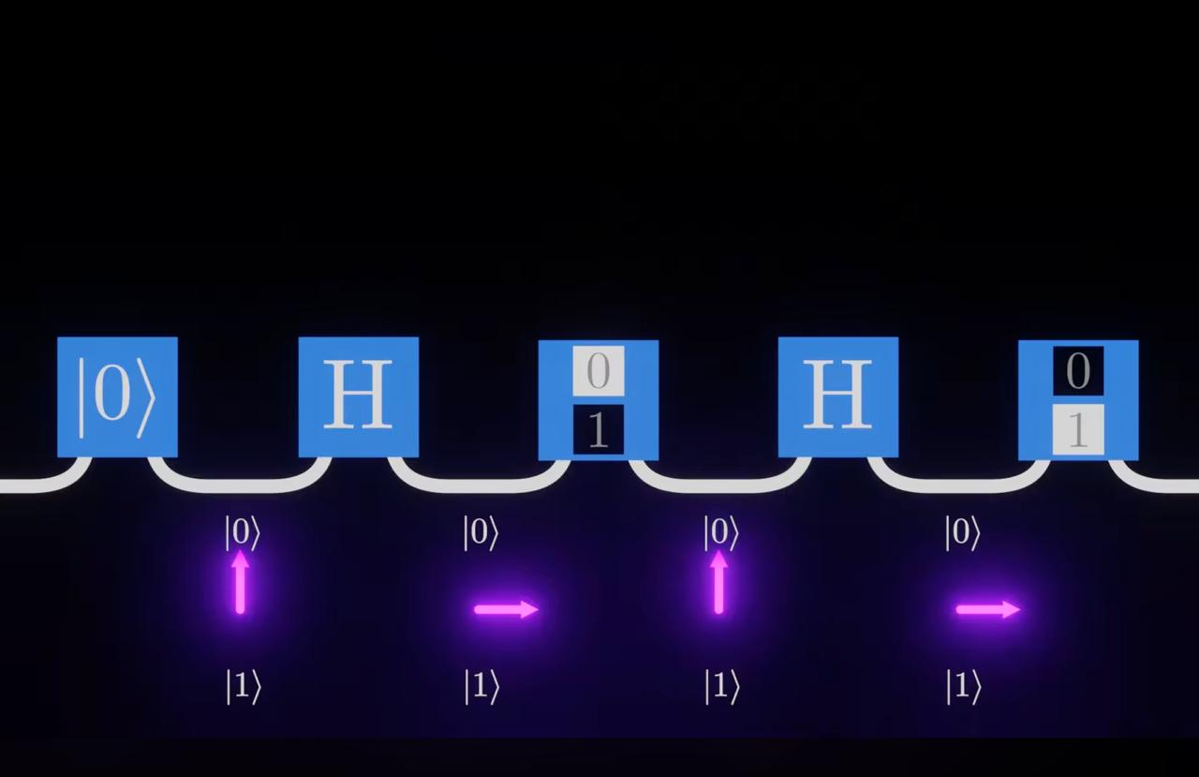

Slide 16
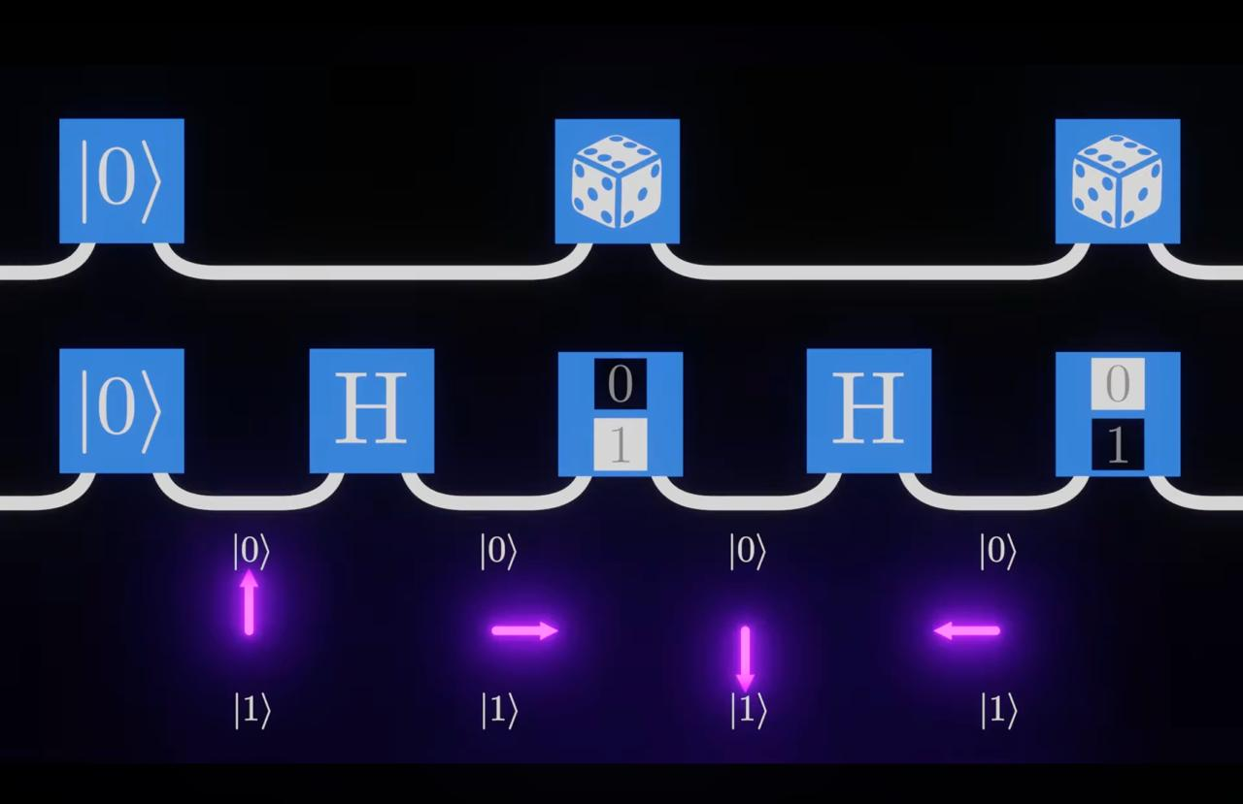

Slide 17
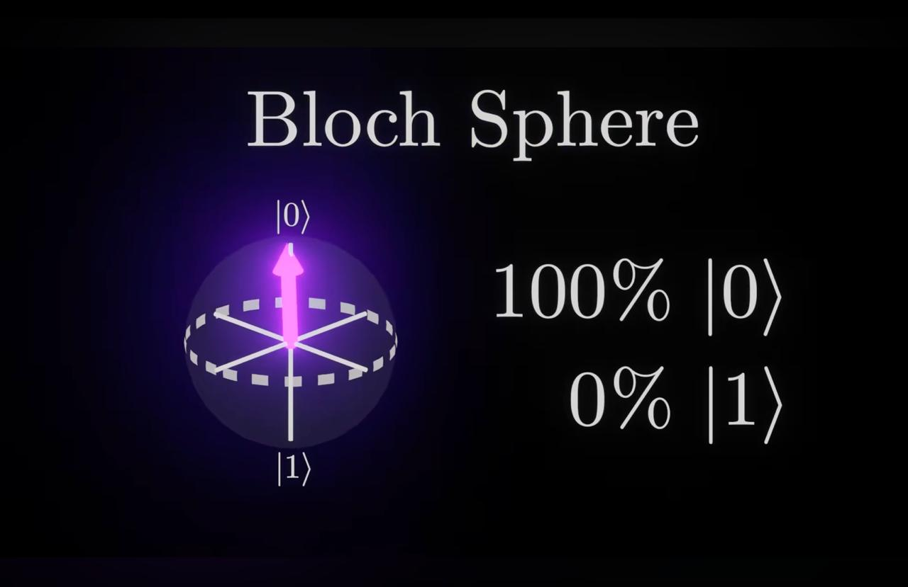

Slide 18
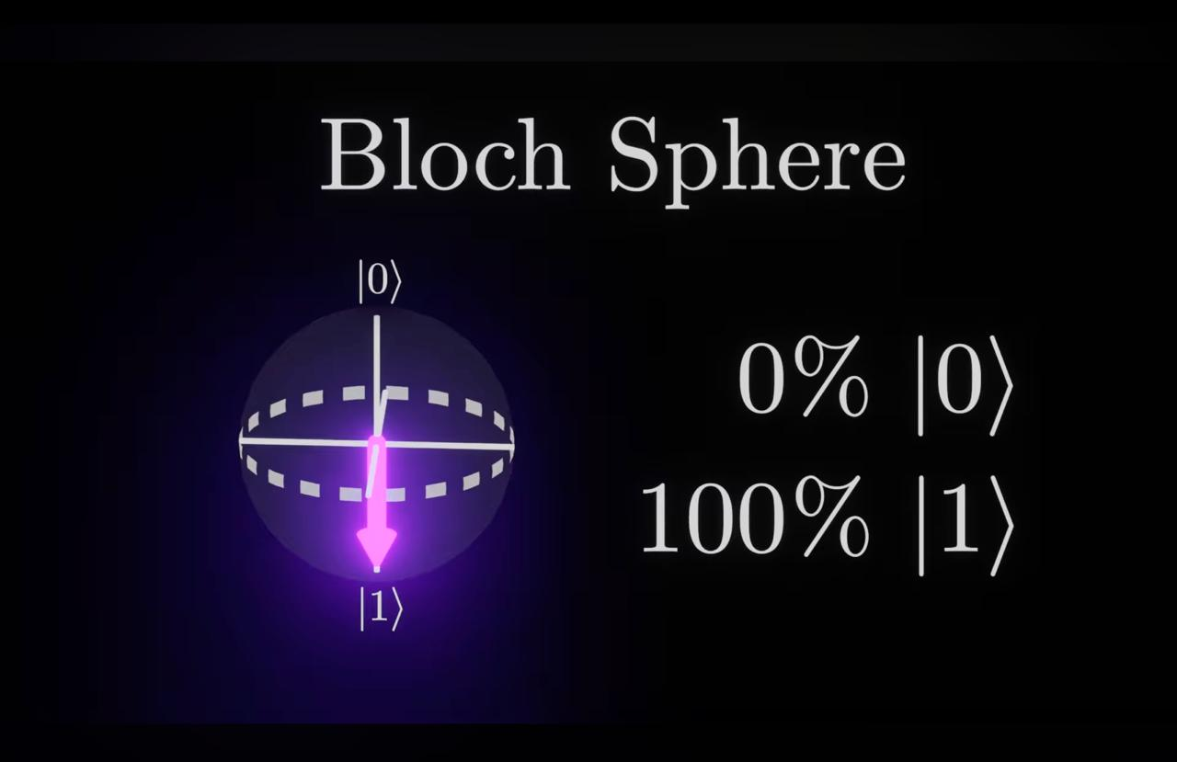

Slide 19
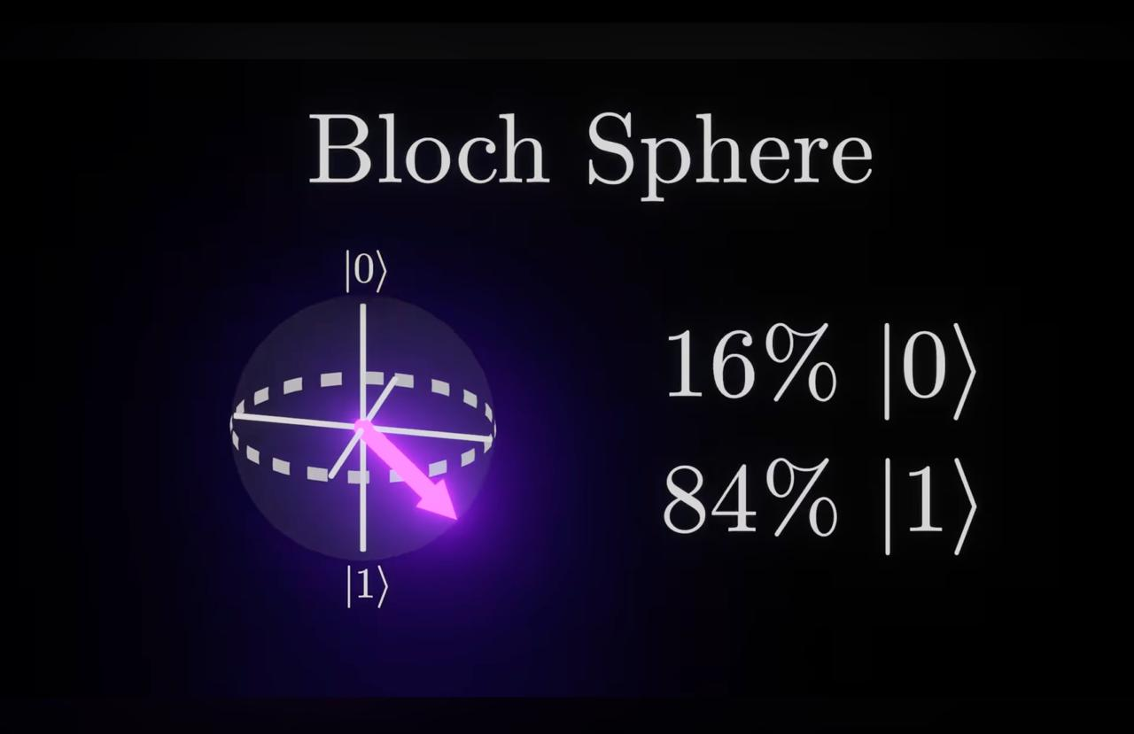

Slide 20
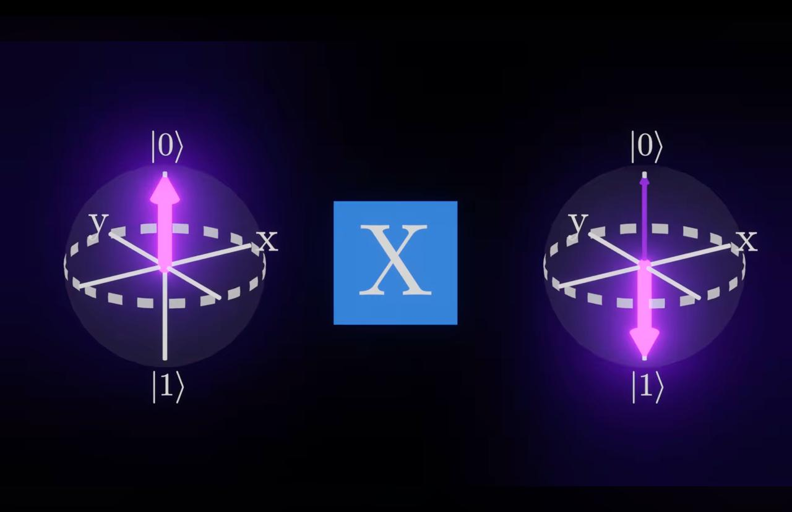

Slide 21
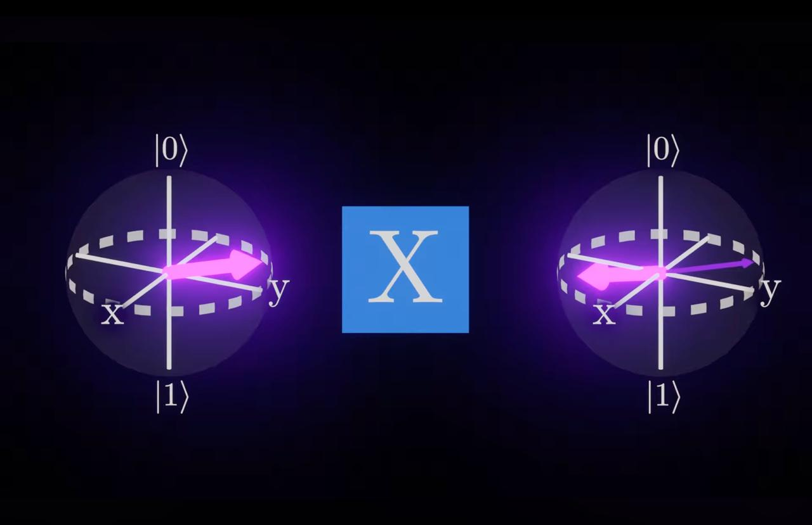

Slide 22
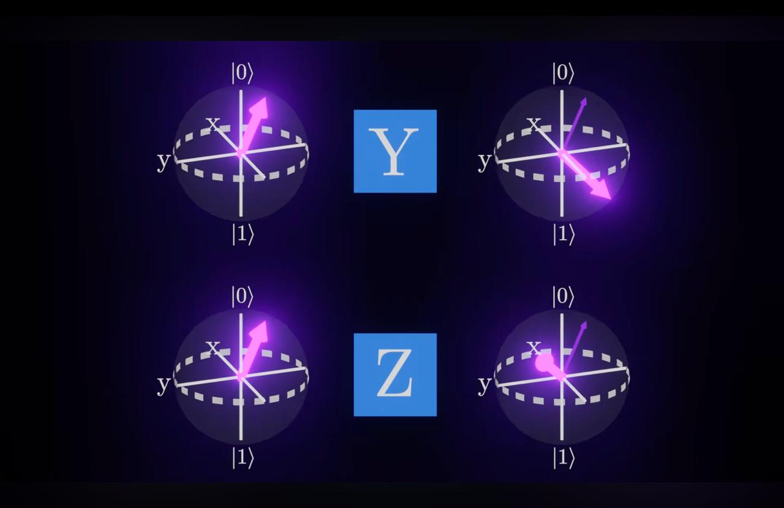

Slide 23
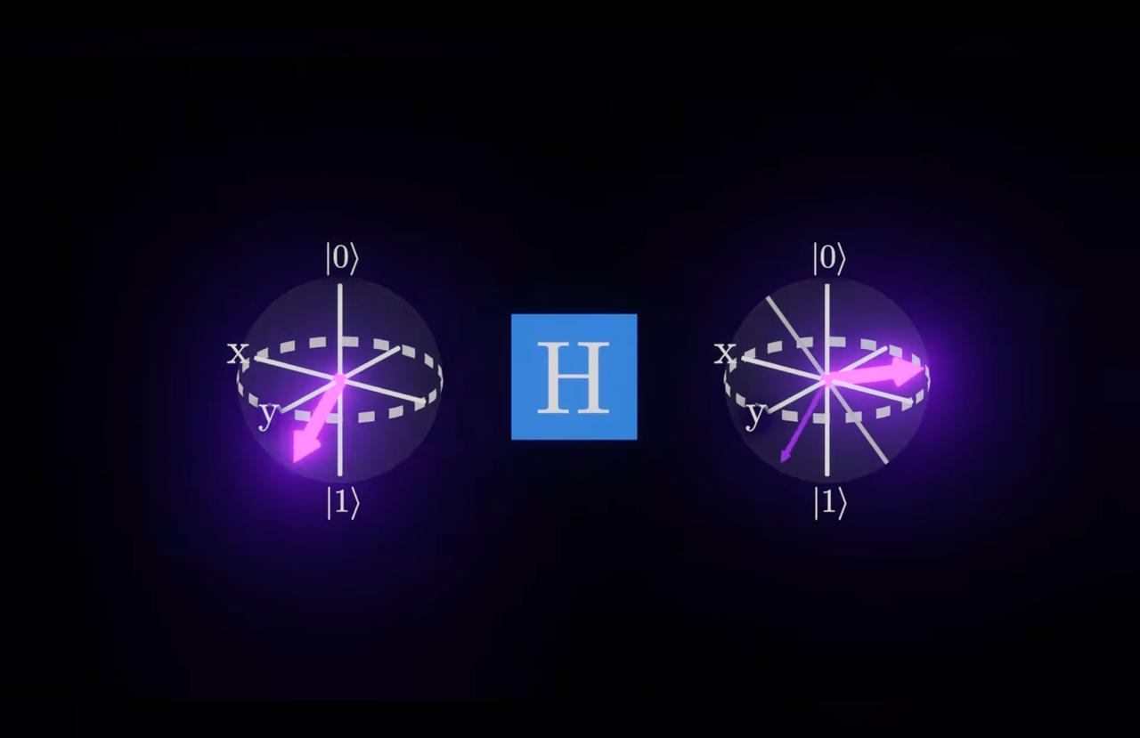

Slide 24
